Slide 1
Query Processor Compilation
Distributed Normal Form and Query compilation architecture

Slide 2
Classic Garlic-style Query Compilation Architecture

Slide 3
Classic Garlic-style Query Compilation Architecture
Source wrappers :
contiguous sub plan vs
pull down.
(Exhaustive) Search Space:
STARs vs
Plan Graph
Optimization :
Staged
Holistic
Delegation :
search space for source
delegating to source (super node from Fall)
Rewrite Rules Paradigms:
Greedy/Heuristic
Exhaustive
Cost Model :
How to normalize across sources
How to get cost for each source
Rewrite Rule Classes :
Join ordering
Pushing selections
Apply-plan Removal
Eager Lazy Aggregation
Semijoin-Reduction

Slide 4
Decoupling dimensions
Assume the following :
Garlic-Style architecture
Contiguous sub plans
Source wrappers are not allowed to change the order of operators. We may introduce this later when performing operator pull-down.
We should decouple the two questions :
Does a unique DNF for our purposes exist?
If not so, can we motivate an operator pull down by source wrappers?
Obviously, we cannot achieve 2) without achieving 1).
Notes:
Garlic-Style architecture, where source wrappers decide (somehow) given the DNF which operator should be processed at which source such that each source is assigned a contiguous sub plan.

Slide 5
Criteria for existence of a unique DNF
Given a set of supported sources, there exists a unique DNF for our purposes if :
Given any SQL++ query (using only the supported sources) and our assumptions, assume an efficient plan for that query exists.
There exists a unique DNF for our purposes if that DNF can express the plan.

Slide 6
Normal Forms
In order to construct DNF, we first need to build normal forms for each source we want to support :
SQL
MongoDB
Jaql
Hive
At this moment, we only have normal forms for SQL and MongoDB.

Slide 7
SQL and MongoDB Normal Forms
With the SQL++ language, source and distributed normal forms have to cover three dimensions :
Operators : which operators are allowed by the normal form and in what order.
Data model : what is the model of the data processed at the source.
Configuration : what are the source requirements of the configuration of operators.
The normal forms that follow only consider the first dimension.

Slide 8

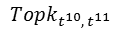
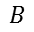
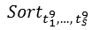
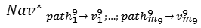
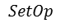

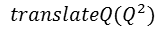
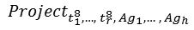
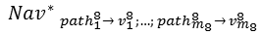
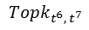
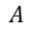
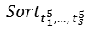
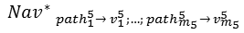

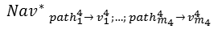

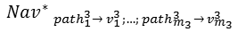

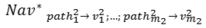

translateQ(Q)
Query format in SQL++
Requirements
Important : this normal form needs to be updated, the select_t1 clause is not at the appropriate position
SQL Normal Form

Slide 9
SQL Normal Form (continued)

Slide 10
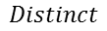
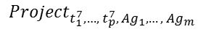
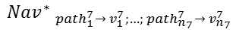
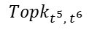
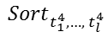
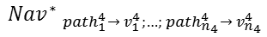
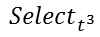
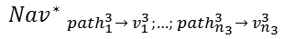

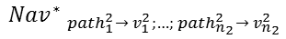
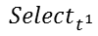
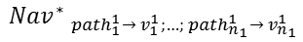
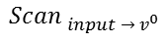
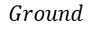
translateQ(Q)
Query format in SQL++
Requirements
: Size of output of query restricted to 16MB, and single operator cannot use more than 10% of system RAM
SELECT DISTINCT
t₁⁷,
…,
t_{p}⁷
f₁^{A} (t_{1,1}²,…, t_{1,k1}²) AS Ag₁,
…,
f_{m}^{A} (t_{m,1}²,…, t_{m,km}²) AS Ag_{m}
FROM
input
WHERE
t¹
GROUP BY
t₁², …, t_{k}²
HAVING
t³
ORDER BY
t₁⁴, …, t_{l}⁴
LIMIT
t⁵
OFFSET
t⁶
MongoDB Normal Form

Slide 11
The translate function will transform the input query into a plan according to the DNF.
The following restrictions apply :
We present here a simple DNF in which only SPJ queries (and subqueries) are allowed. We will extend the list of operators this DNF supports later on.
Distributed Normal Form

Slide 12
We can also represent the normal form as a grammar and plans it can express as words from the grammar.
Distributed Normal Form

Slide 13
Example Schema
Consider only first dimension :
Assume flat tables, homogeneous tuples.
Assume that if a source supports an operator, its supports all its configurations.
Assume following schema :
Postgres.photo : {{
{ photo_id : number, photo_title : string, photo_data : binary, album_ref? : number }
}}
MongoDB.album : {{
{ album_id : number, album_title : string }
}}
Assume photo binaries are large and there are fewer albums than photos.

Slide 14
Example Query
SELECT P.photo_id
FROM Postgres.photo as P, MongoDB.album as A
WHERE FaceRecognition(P.photo_data,”jules”) AND
A.album_id = P.album_ref AND
A.album_title = “vacation 2013”

Slide 15
DNF can express a plan equivalent to the ideal plan
Ideal efficient plan
Plan expressible by DNF

Slide 16
Conclusion
Assume the ApplyPlan operator is implemented efficiently.
The equivalent plan expressed by DNF is also efficient.
Claim : result can be generalized to any reordering.
Unique DNF can be constructed under the assumptions.
We may want to extend our scope to include other operators and/or other dimensions.

Slide 17
Unique Plan Problem
Assume the DNF given above. We know we can express the ideal plan.
Question : Can we find it?
The rewriters that output the DNF are source-agnostic.
Question : Can the rewriters choose a unique efficient plan?
Answer : No, see example.

Slide 18
Example
Take the previous example, but switch sources. The query becomes :
SELECT P.photo_id
FROM MongoDB.photo as P, Postgres.album as A
WHERE FaceRecognition(P.photo_data,”jules”) AND
A.album_id = P.album_ref AND
A.album_title = “vacation 2013”

Slide 19
Rewriter for DNF cannot choose best plan
Plan A
Plan B
Which plan is best depends on selectivity of the inner join, the selection, the cost of the expensive UDF and the bandwith/latency of the network.

